Slide 1
Optimize UFC fights for betting
BOXING
CENTER
List of tools/technologies used in this project
NumPy
Pandas
Matplotlib

Slide 2
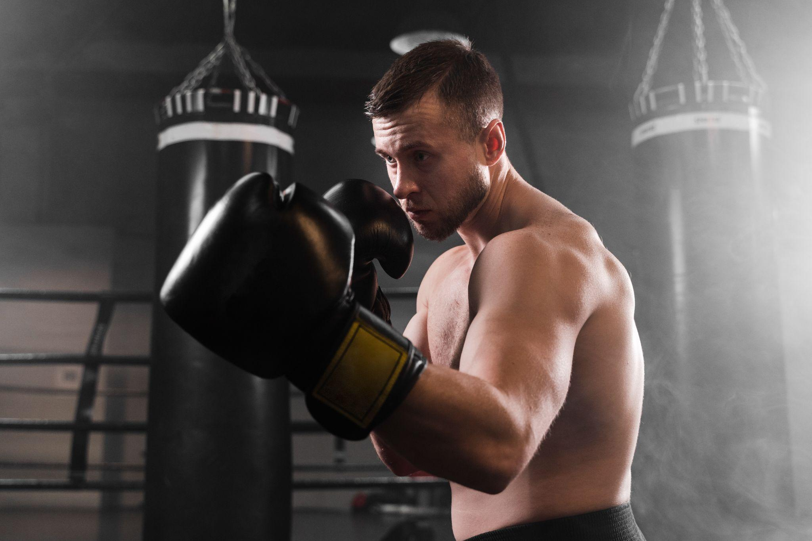

Optimize UFC fights for betting
List of tools/technologies used in this project
NumPy
Pandas
Matplotlib
SkLearn
Streamlit

Slide 3
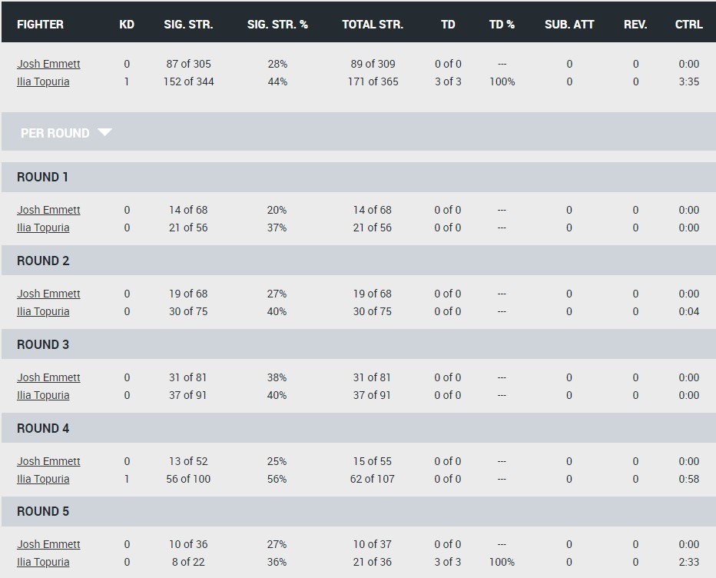
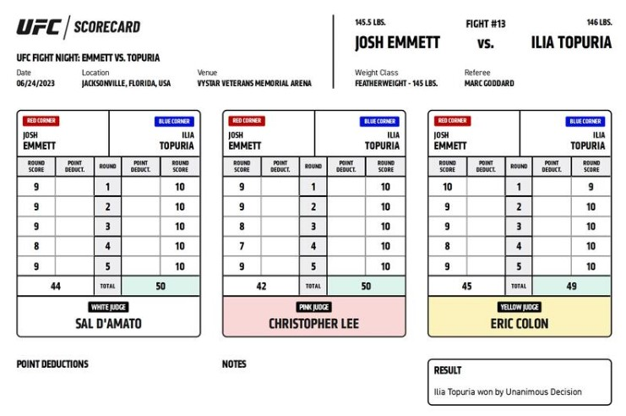
UFC judges score scheme

Slide 4
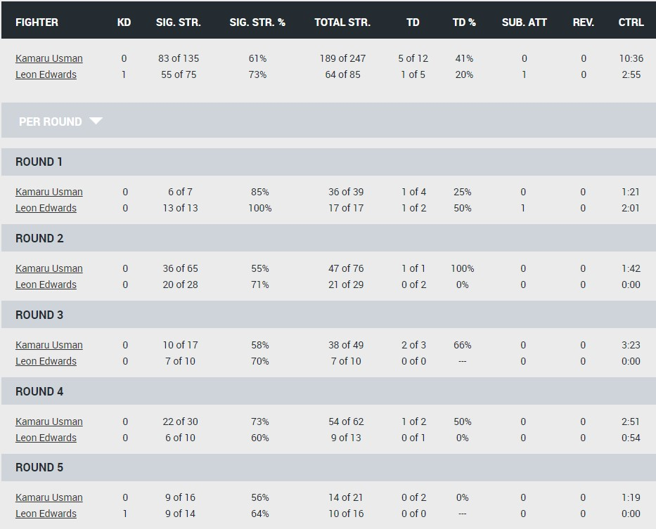
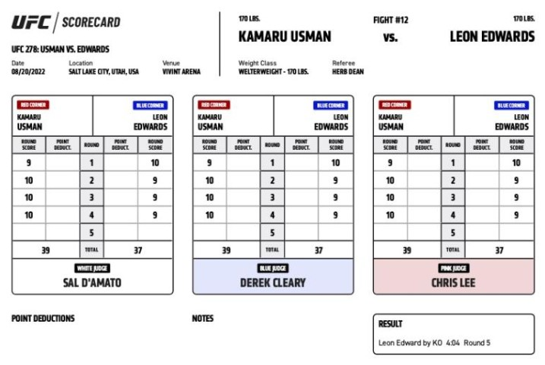
UFC judges score scheme

Slide 5
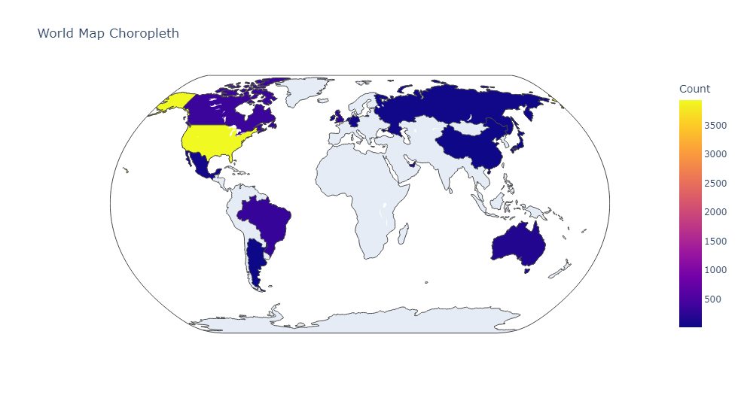
Countries of hosting UFC
Canada – 365
Brazil – 333
UK – 255
Australia – 173
Mexico - 72

Slide 6
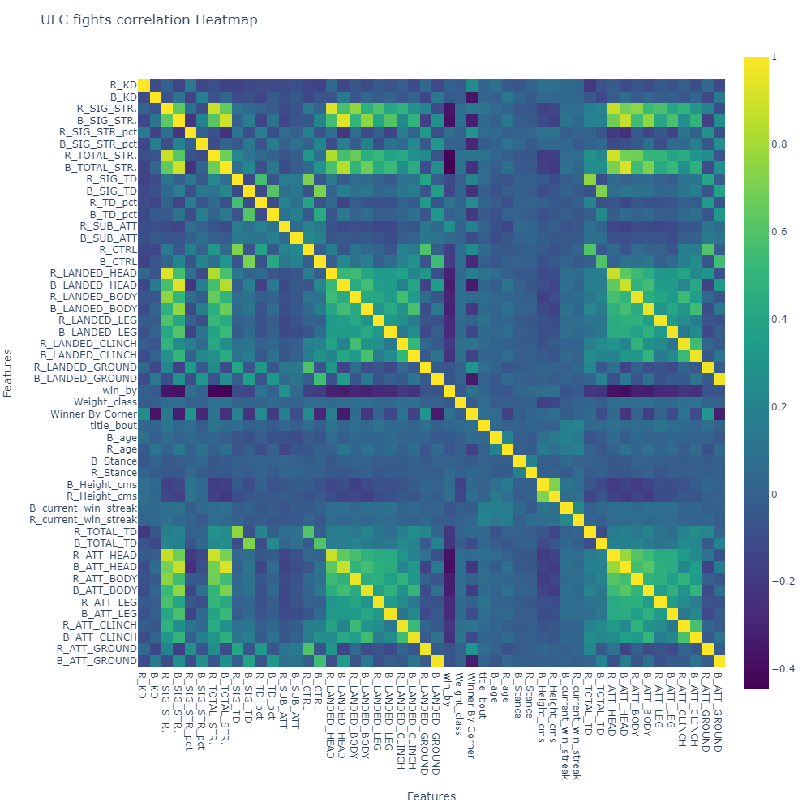
UFC fights correlation heatmap

Slide 7
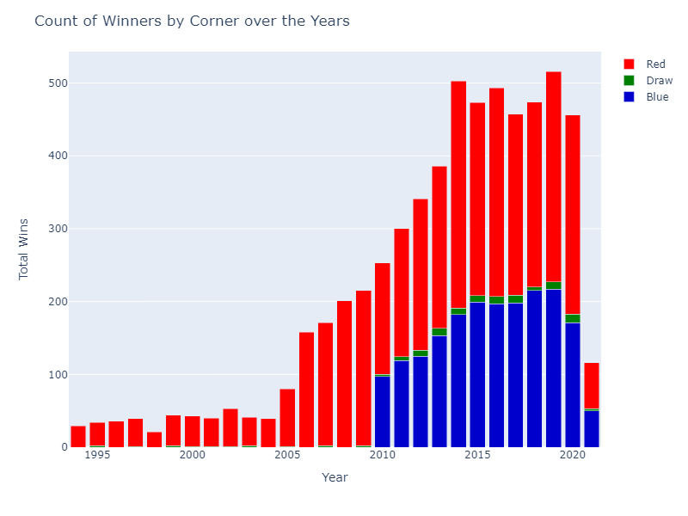
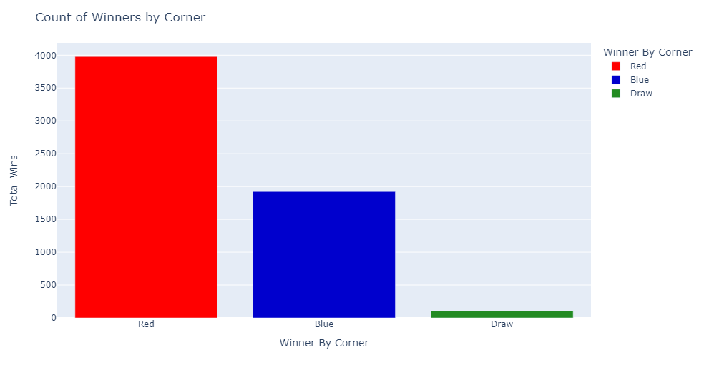
UFC Winners by corner

Slide 8
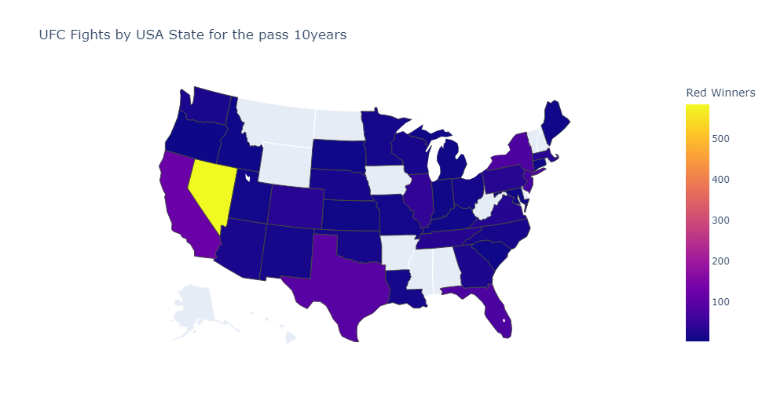
UFC fights by USA states
Nevada - Red 586 / Blue 411
California - Red 121 / Blue 92
Texas - Red 97 / Blue 78
New York - Red 80 / Blue 59
Florida - Red 79 / Blue 69

Slide 9
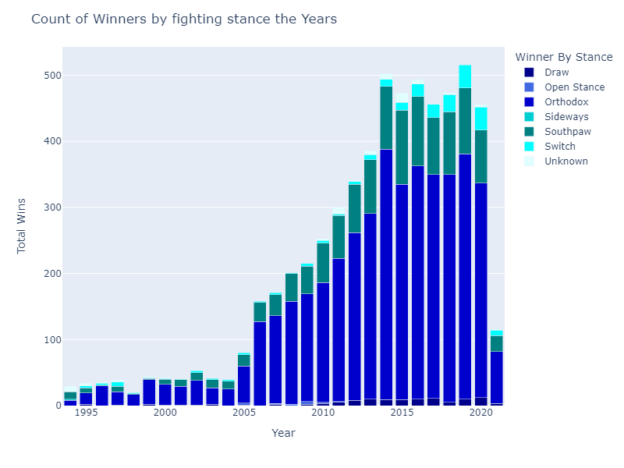
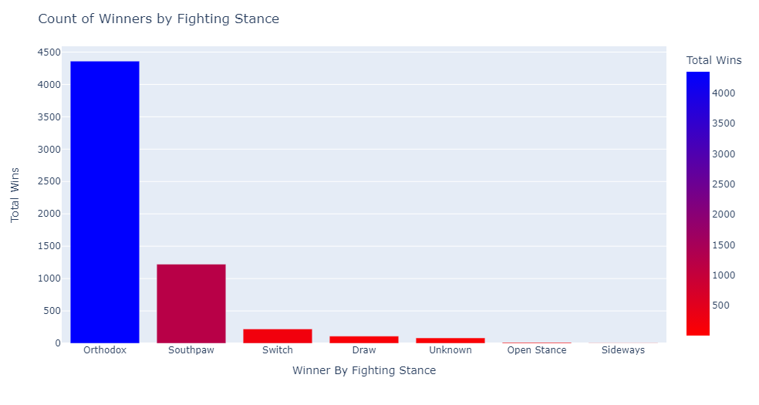
UFC Winners by fighting stance

Slide 10
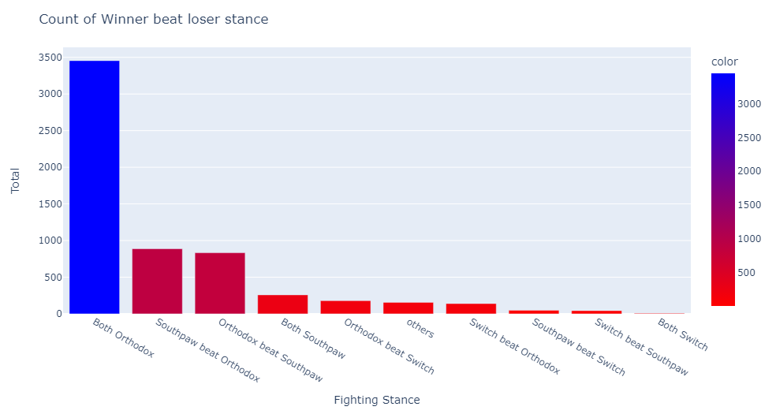
UFC Winners by fighting stance

Slide 11
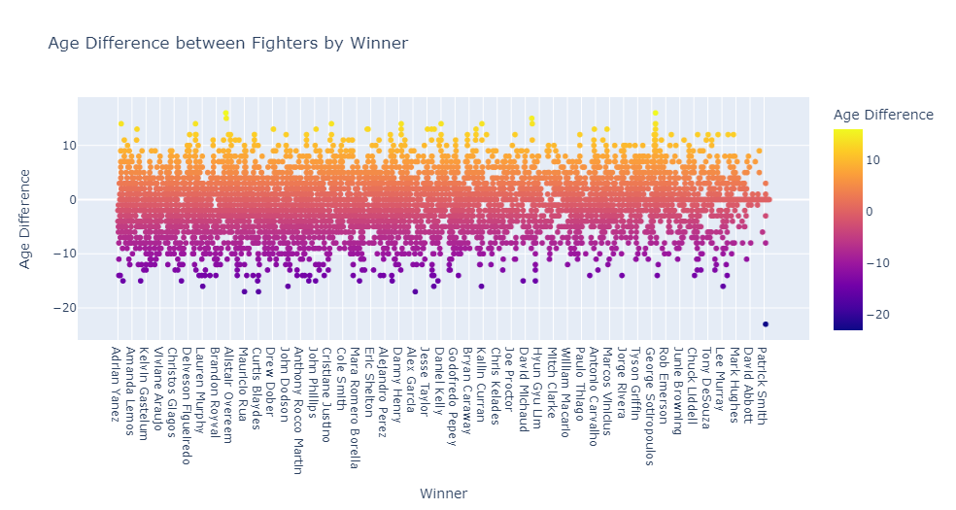
Age difference between fighters

Slide 12
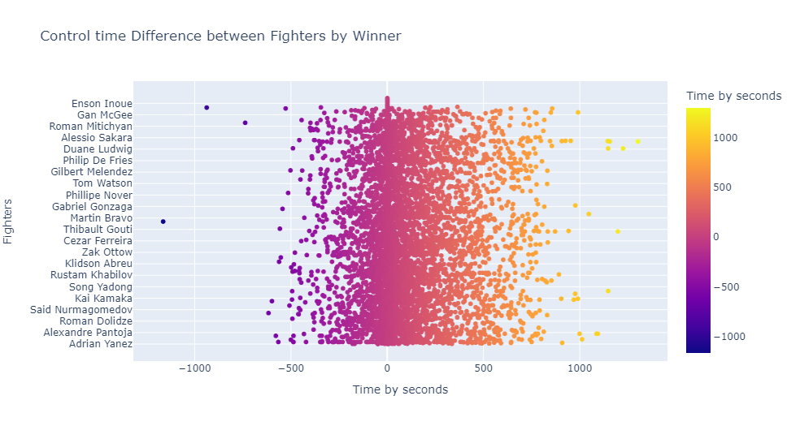
Control time difference between fighters

Slide 13
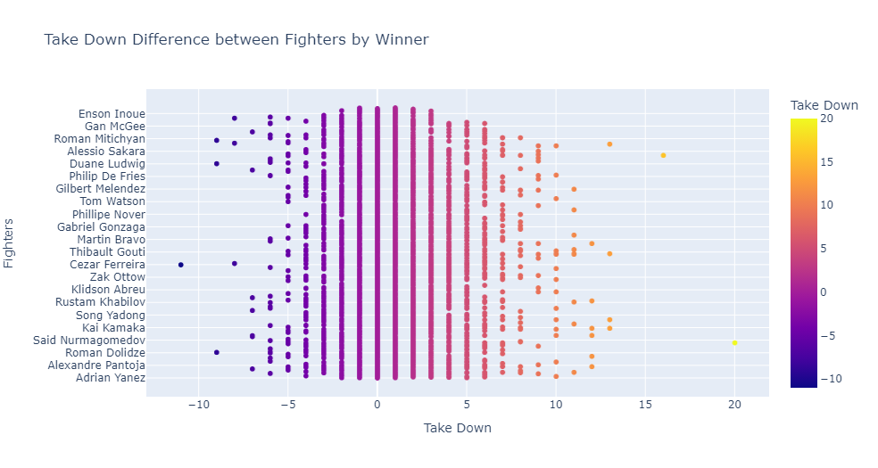
Take Down difference between fighters

Slide 14
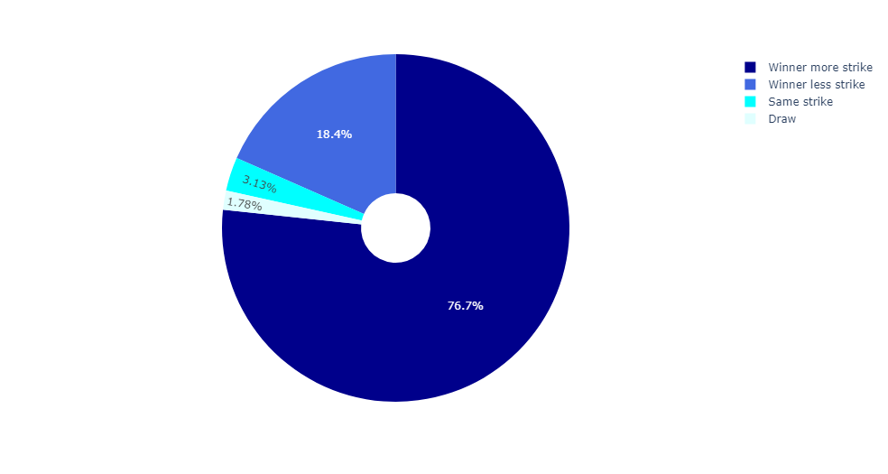
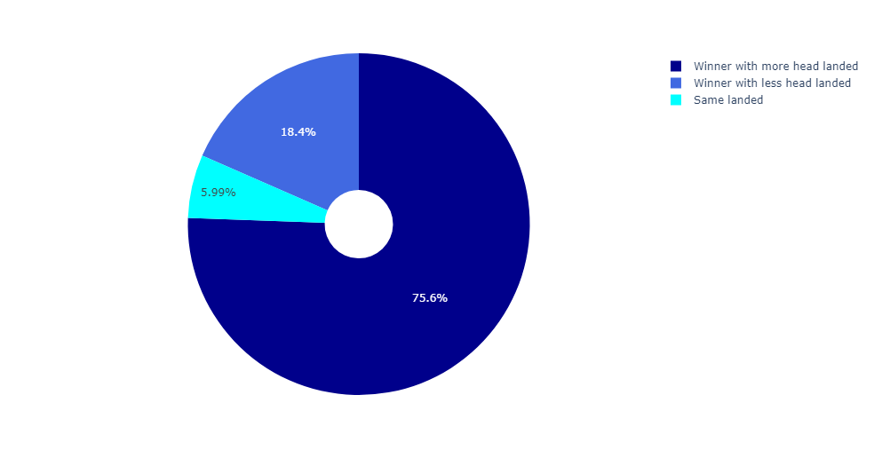
Winner with more striking
Winner with more head landed

Slide 15
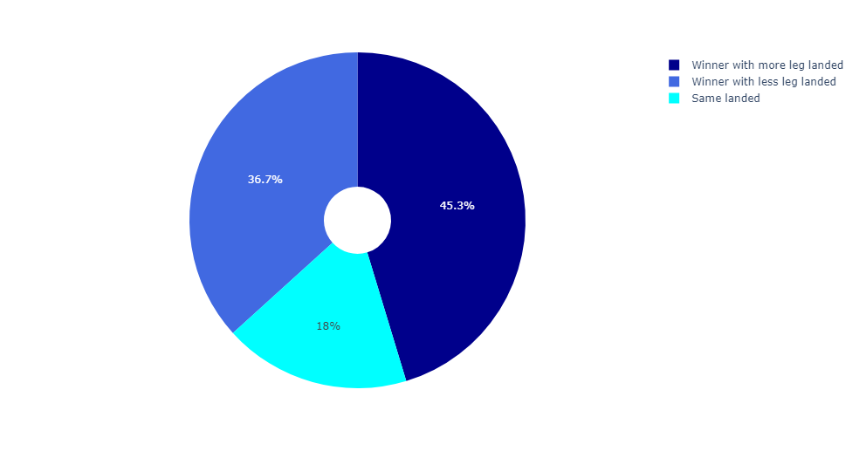
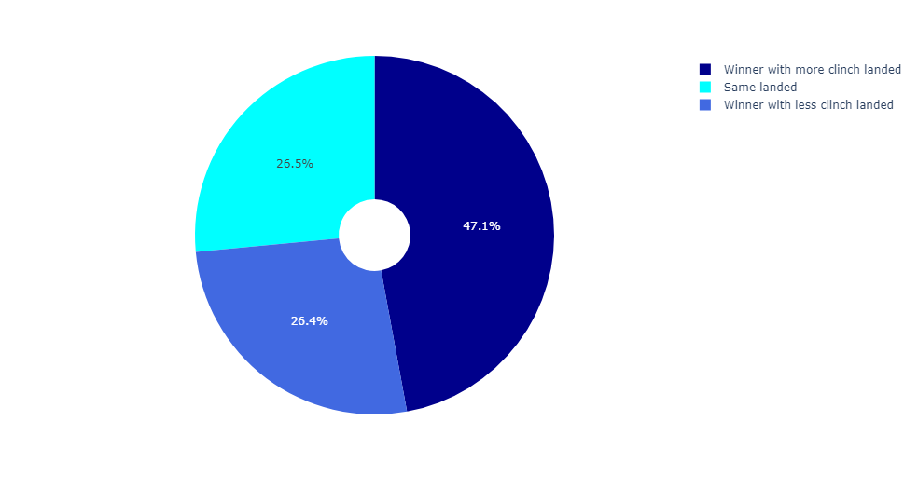
Winner with leg landed
Winner with clinch landed

Slide 16
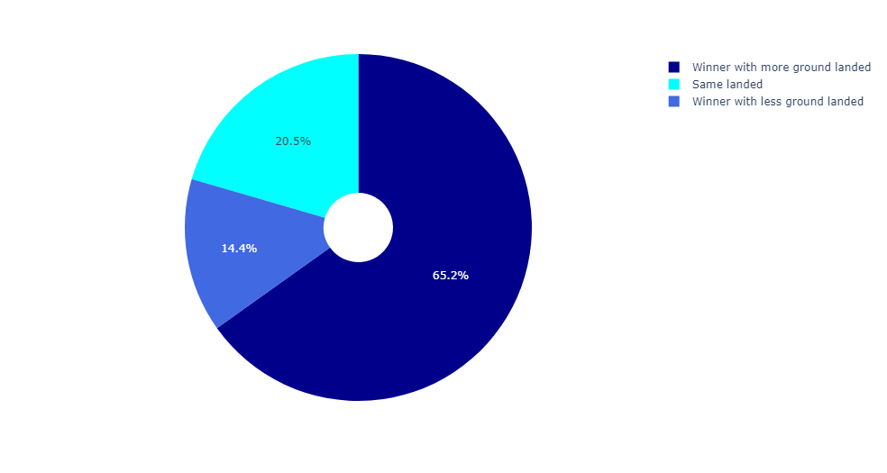
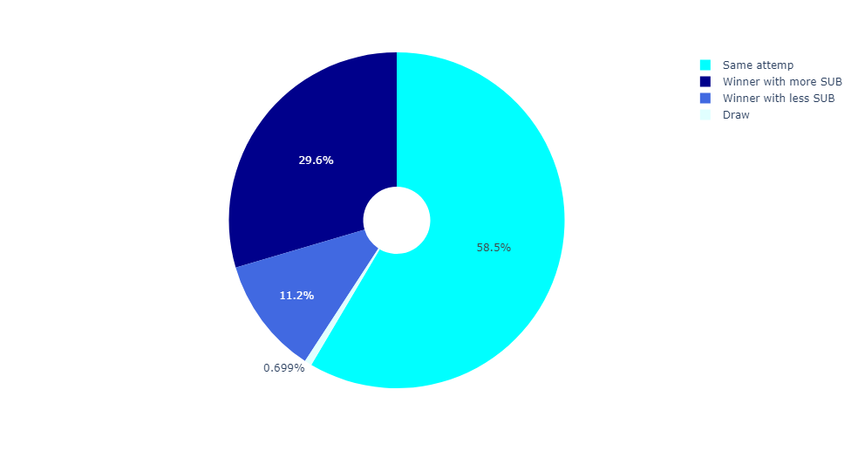
Winner with more ground and pound
Winner with more SUB

Slide 17
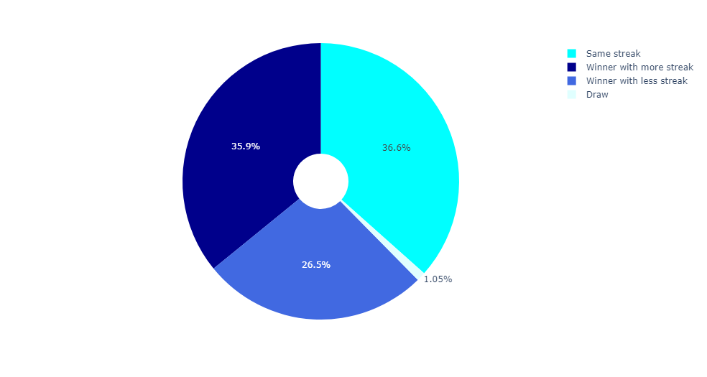
Winner with more winning streak

Slide 18
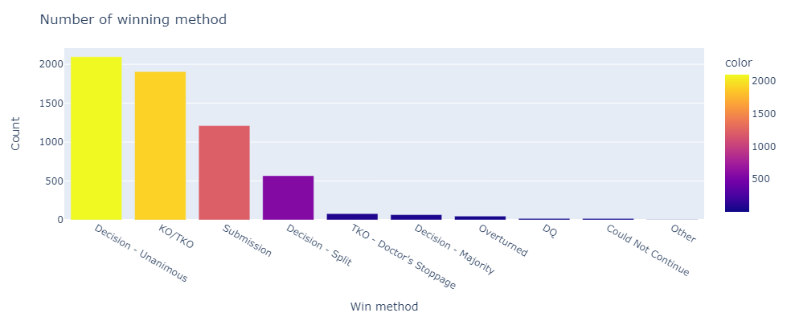
Winner with winning method

Slide 19
Conclusion
Striking skills
Control Times
Take Down
Winning method (KO/Submission)
Figther Corner
Figthing Stance
Winning Streak

Slide 20
THANK YOU!

